Slide 1
Consequences of CO2 emissions
Costs v. benefits
Dave Burton

Slide 2
Benefits:
CO2 Fertilization, improves crop yields →
Improved drought resistance / water use efficiency →
Warmer, more equable climate, extended growing seasons, esp. at high latitudes →
The first two benefits are proven.
Costs: (alleged):
Accelerated sea-level rise →
Worsening extreme weather
Warmer climate hurts agricultural productivity
Crops become less nutritious
Polar bears, coral, Bramble Cay Mosaic-Tailed Rat
Those costs are hypothetical.

Slide 3
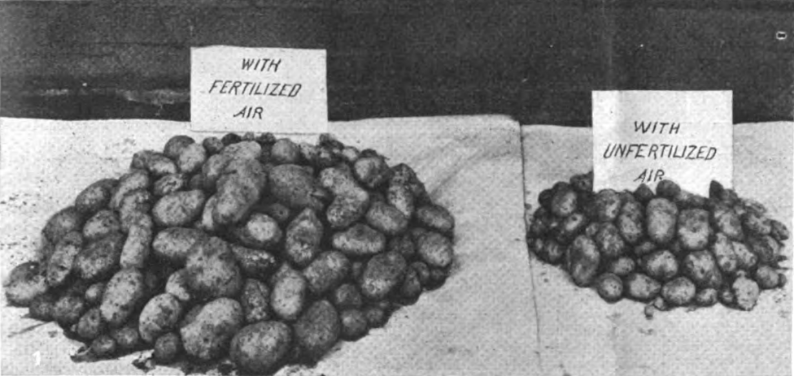
CO2 Fertilization improves crop yields
Known to science for a century; Scientific American called anthropogenic CO2 “the precious air fertilizer” in 1920.

Slide 4
CO2 Fertilization improves crop yields
Average outdoor CO2 level (408 ppmv) is elevated by ~128 ppmv (45%) above “pre-industrial” (Little Ice Age, ~280 ppmv).
Commercial greenhouses use CO2 generators to typically maintain daytime CO2 levels at 1200–1500 ppmv (elevated by at 330%–435% above pre-industrial)
= 7x to 10x the anthropogenic increase in outdoor levels.
Because it is dramatically beneficial for plants.
Harmless to humans and animals (submarines and Int’l Space Station keep levels much higher).

Slide 5
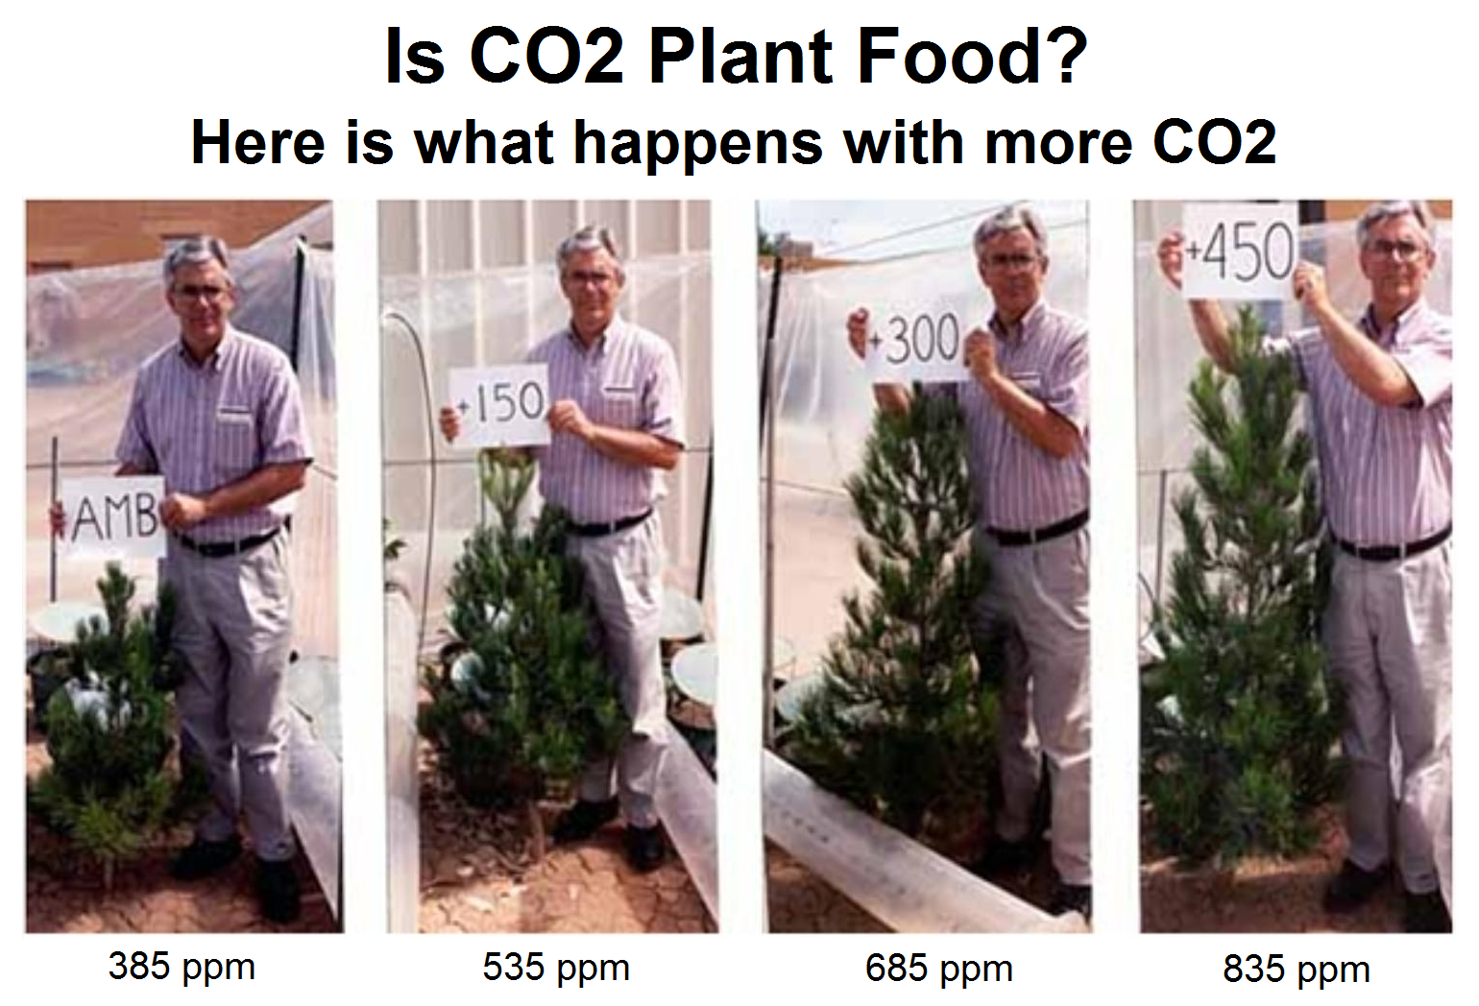

Slide 6
CO2 Fertilization improves crop yields
Thousands of studies confirm:
Large benefits for C3 (and CAM) crops (most plants)
Similar benefits for corn, smaller for other C4 grasses under otherwise-ideal conditions: (millet, sorghum, sugarcane), but large benefits when drought-stressed
15–20% of current agricultural production is a direct result of CO2 fertilization
Without that improved productivity, mankind could approximately make up for the lost output by putting all of the world’s rainforests under cultivation.

Slide 7
Improved drought resistance /
water use efficiency
Even C4 plants benefit greatly from extra CO2 when drought-stressed.
The Earth is “greening” – especially arid regions, like the Sahel
National Geographic reported:
Sahara Desert Greening Due to Climate Change?
James Owen for National Geographic News, July 31, 2009
"Before, there was not a single scorpion, not a single blade of grass … Now you have people grazing their camels in areas which may not have been used for hundreds or even thousands of years. You see birds, ostriches, gazelles coming back, even sorts of amphibians coming back … The trend has continued for more than 20 years. It is indisputable."

Slide 8
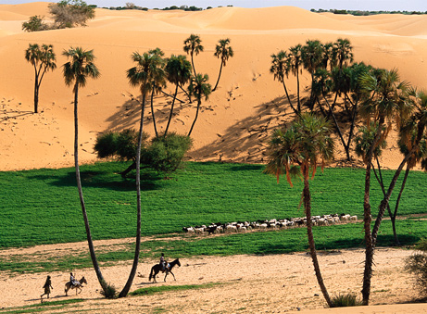
Villagers herd goats near windblown sand dunes in the Sahel region of Niger, North Africa. Vast swaths of North Africa are getting noticeably lusher due to warming temperatures, new satellite images show, suggesting a possible boon for people living in the driest part of the continent.
Photograph by Pascal Maitre/NGS National Geographic News, July 31, 2009

Slide 9
Natural “negative feedbacks” reduce
the effect of CO2 emissions
AR5 estimates 27% [p. 6-3] or 29% [Fig. 6.1] of current anthropogenic CO2 emissions are removed from that atmosphere each year by terrestrial greening.
The percentage seems to be increasing.
AR5 estimates that the oceans remove another 26% [Fig 6.1].
Calcifying coccolithophore growth is increasing, which removes dissolved CO2 from the upper layer of the ocean.
Even though CO2 emissions increased about 2%/year over the last 30 years, less than half of that CO2 stayed in the atmosphere.

Slide 10
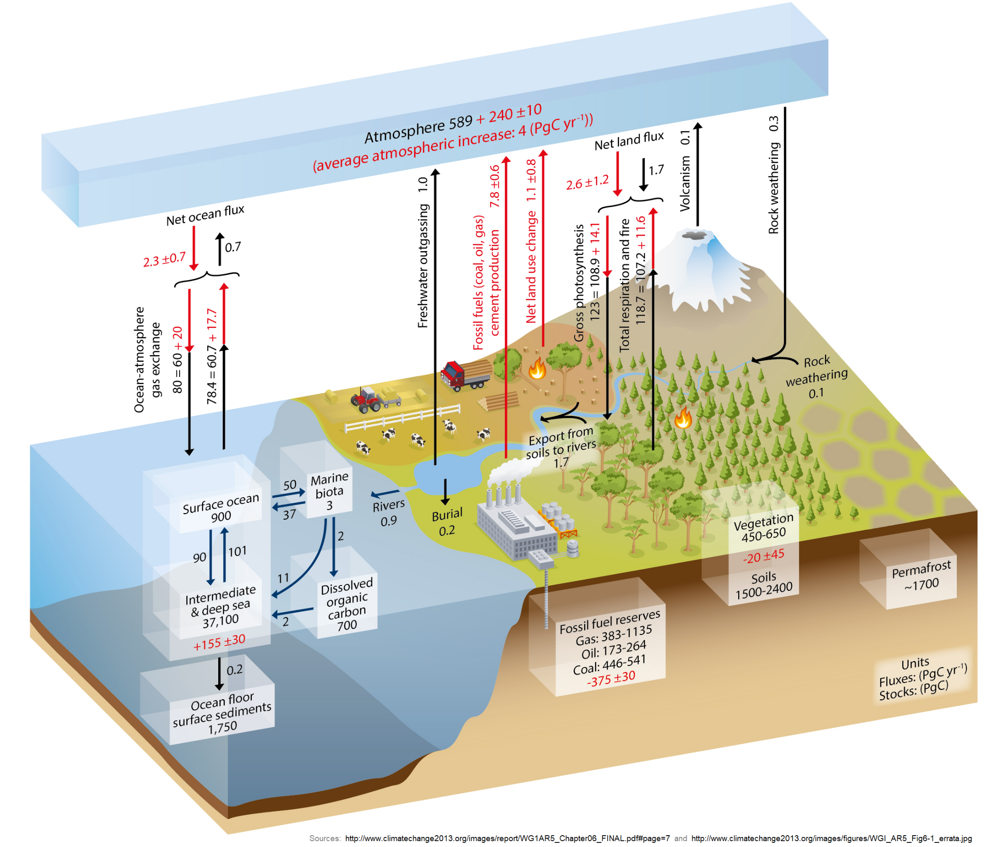

Slide 11
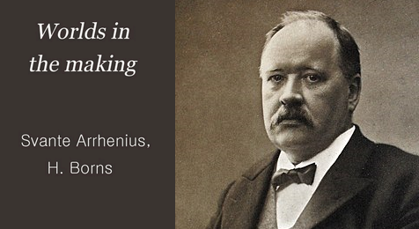
Arrhenius anticipated the
benefits of CO2 emissions
111 years ago
Svante Arrhenius, Worlds in the Making, 1908 (English translation)

Slide 12
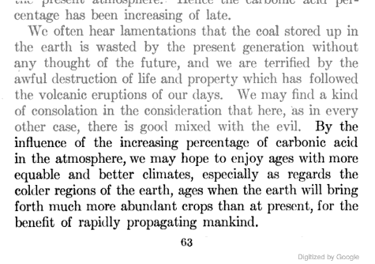
Arrhenius anticipated the
benefits of CO2 emissions
111 years ago
Notes:
12

Slide 13
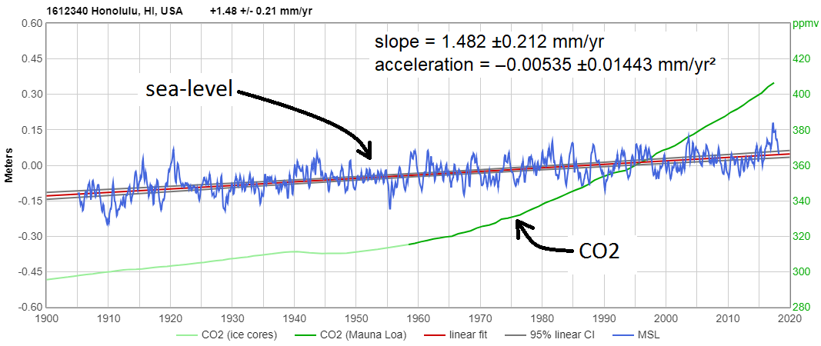
What about sea-level?

Slide 14
Q: Is sea-level rising?

Slide 15
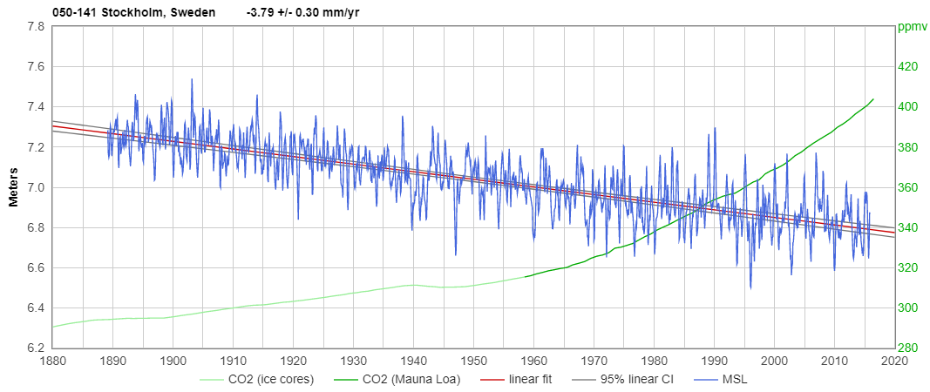
Q: Is sea-level rising?

Slide 16
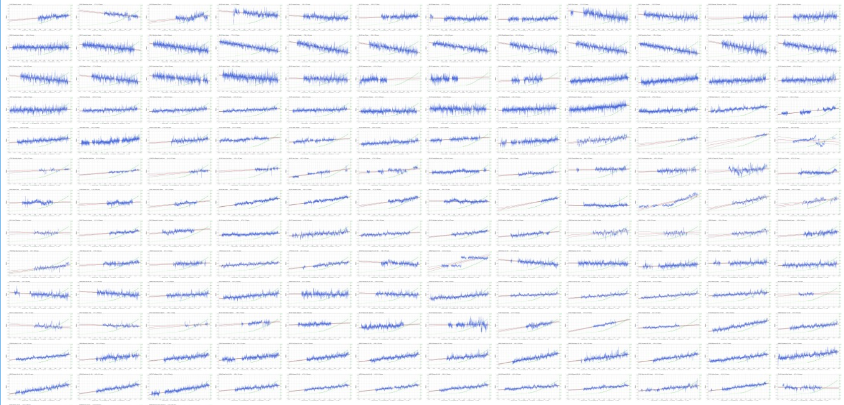
Q: Is sea-level rising?
A: It depends on where you live.

Slide 17
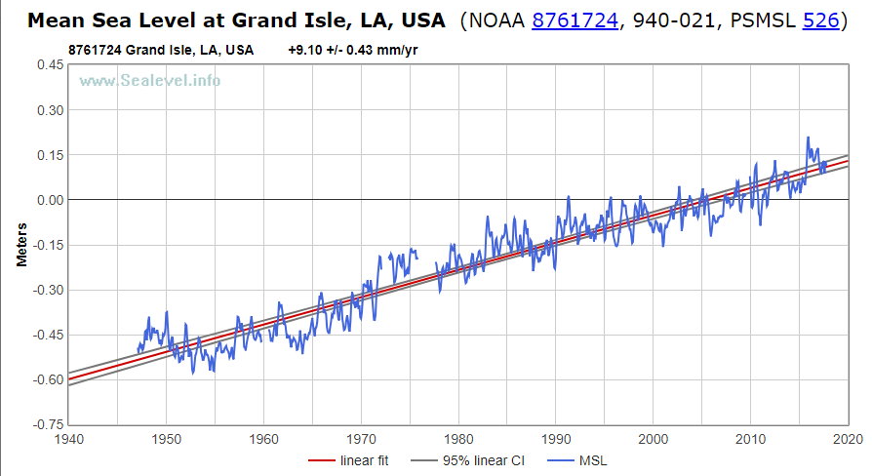
Q: Is sea-level rising?
A: It depends on where you live.

Slide 18
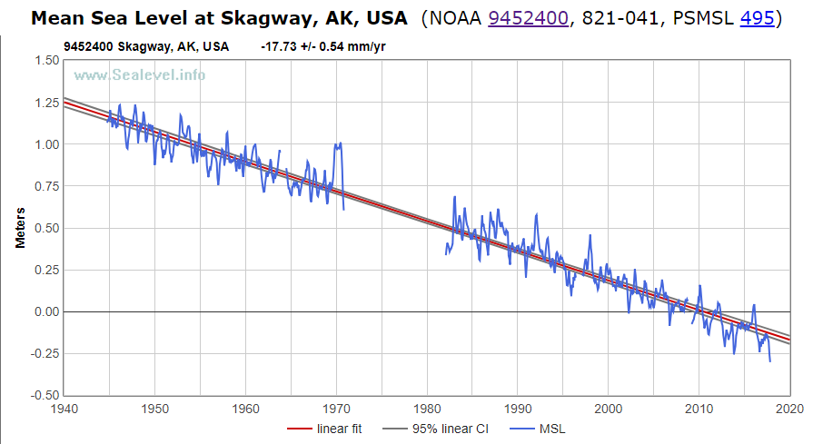
Q: Is sea-level rising?
A: It depends on where you live.

Slide 19
Global average
About +1½ mm/year
= 6 inches per century
6"/century is less than many common coastal processes, like erosion and sedimentation
So not currently a problem. But is it accelerating?

Slide 20
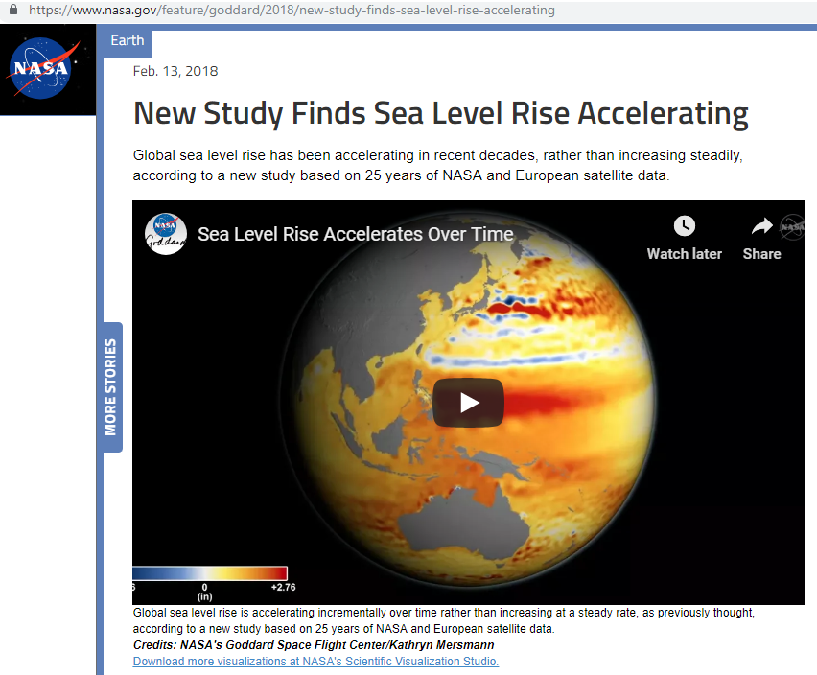
Acceleration

Slide 21
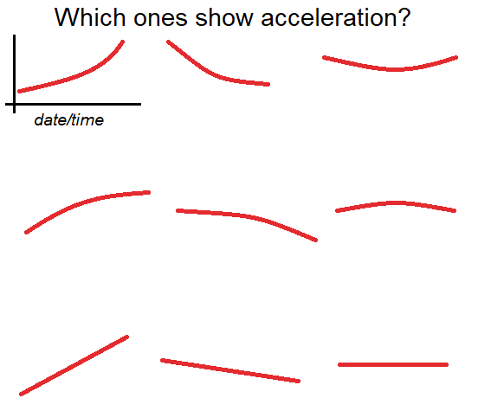
Acceleration

Slide 22
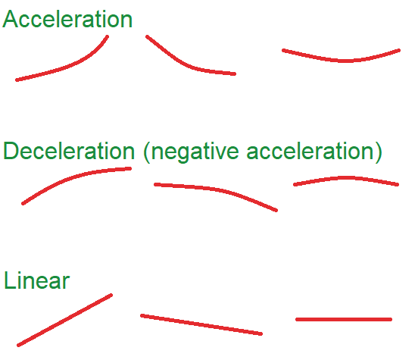
Acceleration

Slide 23
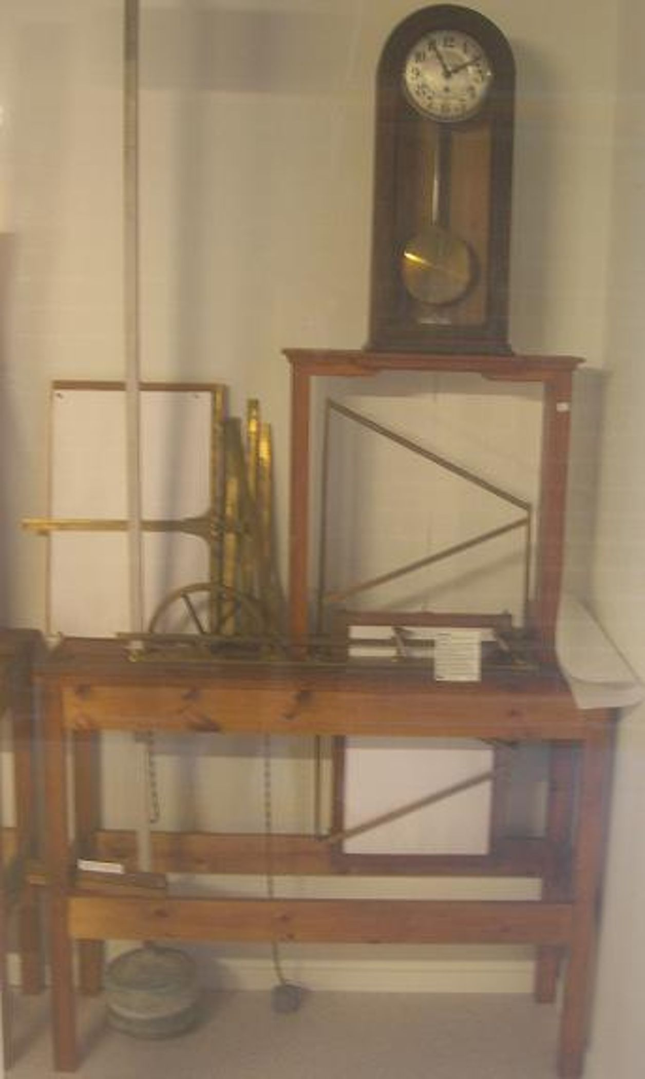
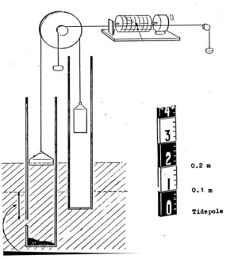
Two ways to measure sea-level
#1. Coastal tide gauges

Slide 24
Two ways to measure sea-level
#1. Coastal tide gauges
Over 1200 locations
Many with >100 years of measurements
Longest is >200 years
Measured at channels and harbors

Slide 25
Two ways to measure sea-level
#2. Satellite altimetry
Only a handful of instruments
Most measurement records are about ten years long
Measures open ocean, can’t measure at coasts
First data is from 1993

Slide 26
What do tide gauges show?
80% show sea-level rising
20% show sea-level falling
Grand Isle, LA = +9 mm/year
Skagway, AK = -18 mm/year
median = +1½ mm/year
nearly all are approx. linear for 90+ years

Slide 27
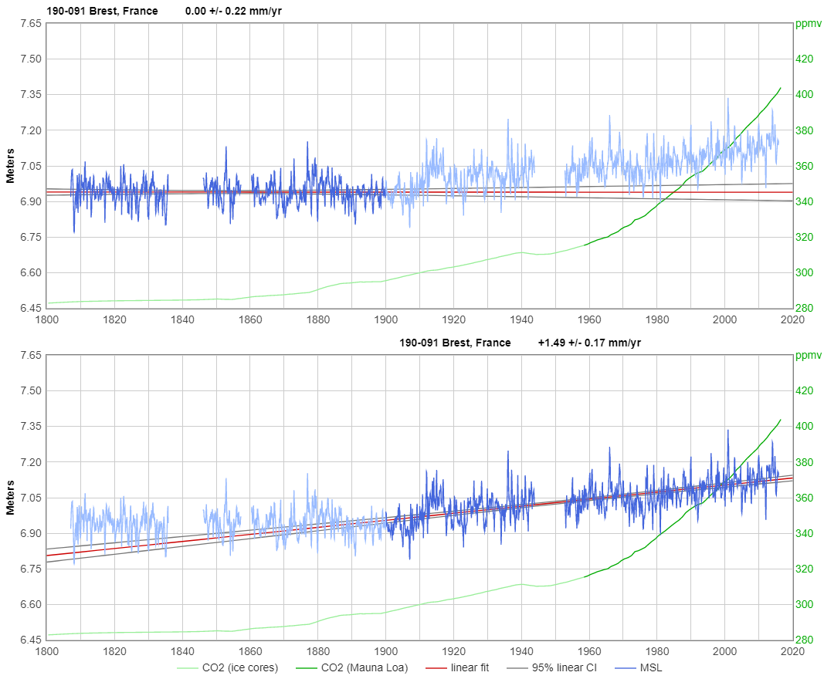
Do any show acceleration?
Yes, some do, before 1930. E.g., Brest, France:

Slide 28
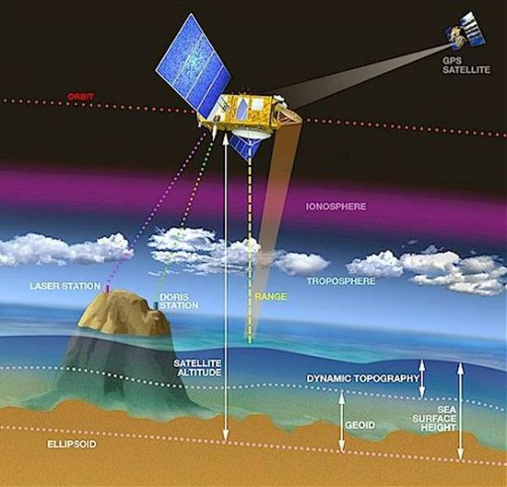
Satellite altimetry

Slide 29
Satellite altimetry
2 to 6 cm wavelength downward radar
satellite orbital position uncertainty
Proposed: Geodetic Reference Antenna in Space (GRASP). (Has not flown.)
Mission lifetimes average about ten years
25 yr record combines a patchwork of different instruments, different orbits, etc.

Slide 30
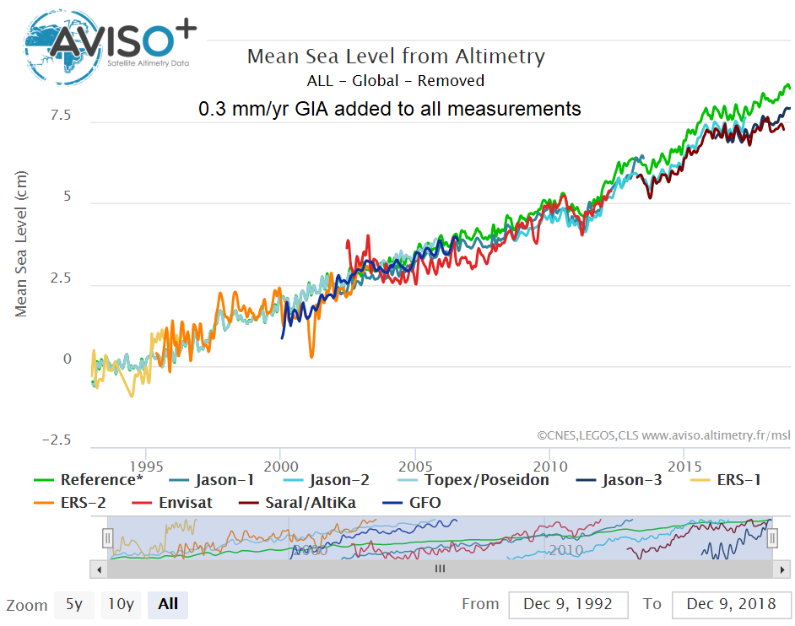
Satellite altimetry

Slide 31
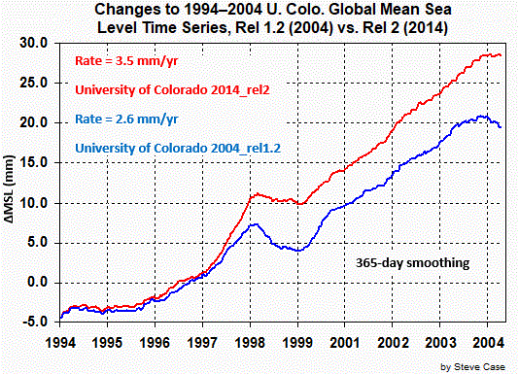
Satellite altimetry
The old data keeps changing!

Slide 32
Satellite altimetry
Steve Case asked why…
Thanks for your inquiry. The sea level time series release from 2004 is over eight years old, and in that time many parts of the TOPEX and Jason-1 processing have been updated to reflect instrument and ancillary data improvements. Without recreating each processing change over the last eight years, I cannot point to any specific update that is the main cause of the differences between the 2004 and the current release. But a partial list of the more influential updates include:
– updated orbits
– updated radiometer corrections
– updated tide models
– updated sea state bias models
– updated dynamic atmosphere
…we continually apply what the altimeter science community considers to be
the most up-to-date set of processing parameters. In fact, the Jason-2 data is currently being re-released and updated to the GDR-D standard, and this will most likely affect the altimeter time series due to these improvements.
— Dallas Masters, Sea Level Research Group, CB431/CCAR, University of Col.

Slide 33
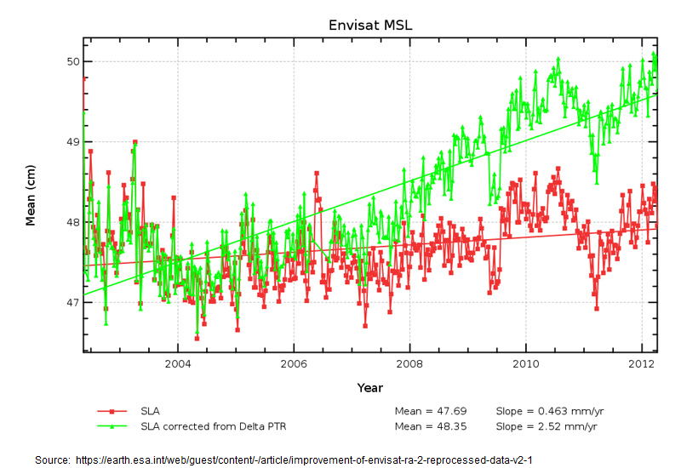
Satellite altimetry

Slide 34
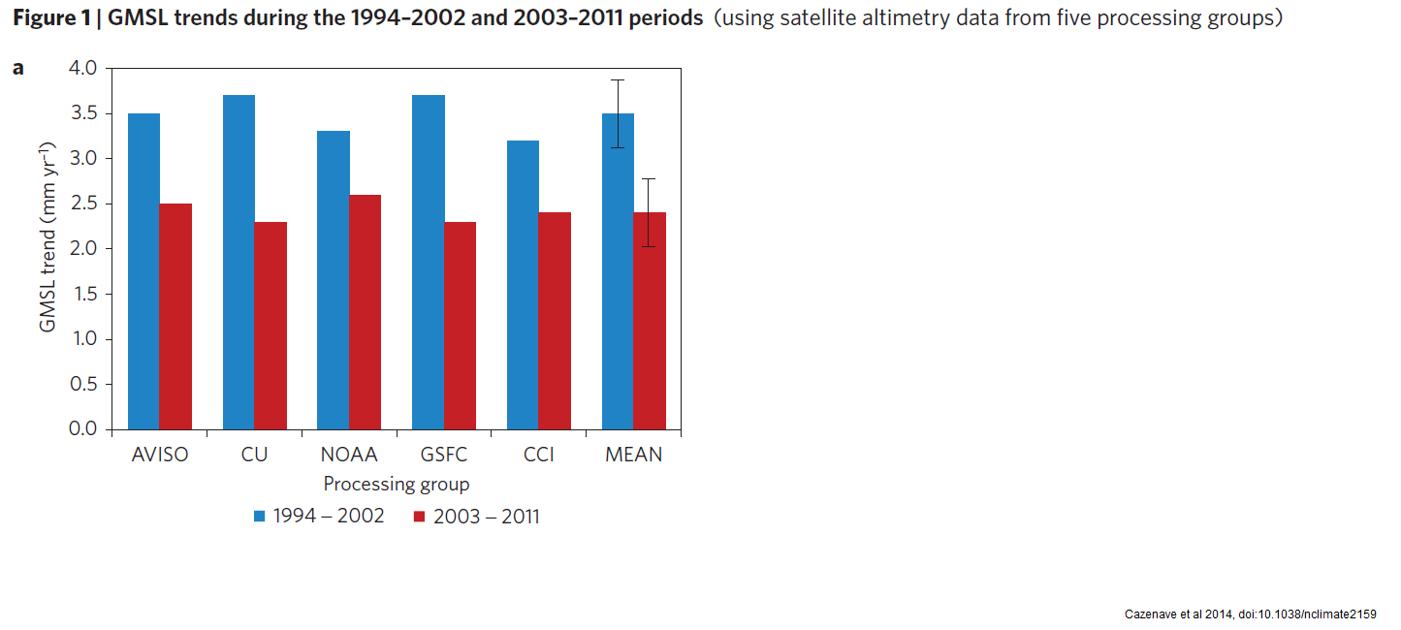
Satellite altimetry
Problem: satellites were showing deceleration

Slide 35
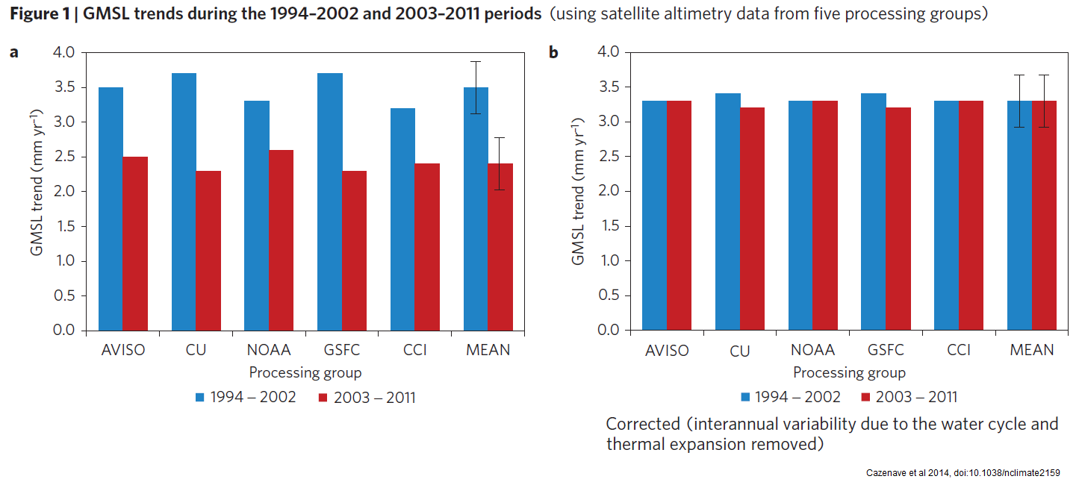
Satellite altimetry
Problem: satellites were showing deceleration

Slide 36
Satellite altimetry
Problem: satellites were showing deceleration
Solution: Cazenave et al 2014. Nature Climate Change volume4, pages 358–361.

Slide 37
Acceleration?

Slide 38
Acceleration?
Torture the data until it confesses!
Solution: Nerem et al 2018.

Slide 39
Acceleration?
Torture the data until it confesses!
Nerem et al 2018 finally found "acceleration" in the satellite data
But how?
Solution: Nerem et al 2018.

Slide 40
Acceleration?
Torture the data until it confesses!
Nerem et al 2018 finally found "acceleration" in the satellite data
But how?
By SLOWING the rate of rise of sea-level rise "measured" by Topex-Poseidon prior to 1998!
They "fixed" 20-year-old data, thereby creating the appearance of acceleration when the early Topex-Poseidon data is compared against the newer satellites' data.
Solution: Nerem et al 2018.

Slide 41
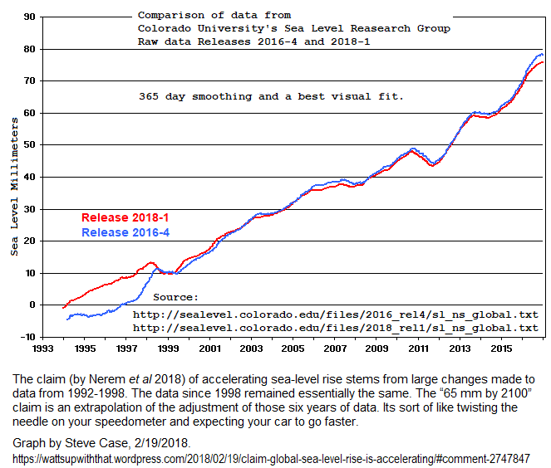
Acceleration?
Torture the data until it confesses!

Slide 42
Finally, Acceleration!

Slide 43
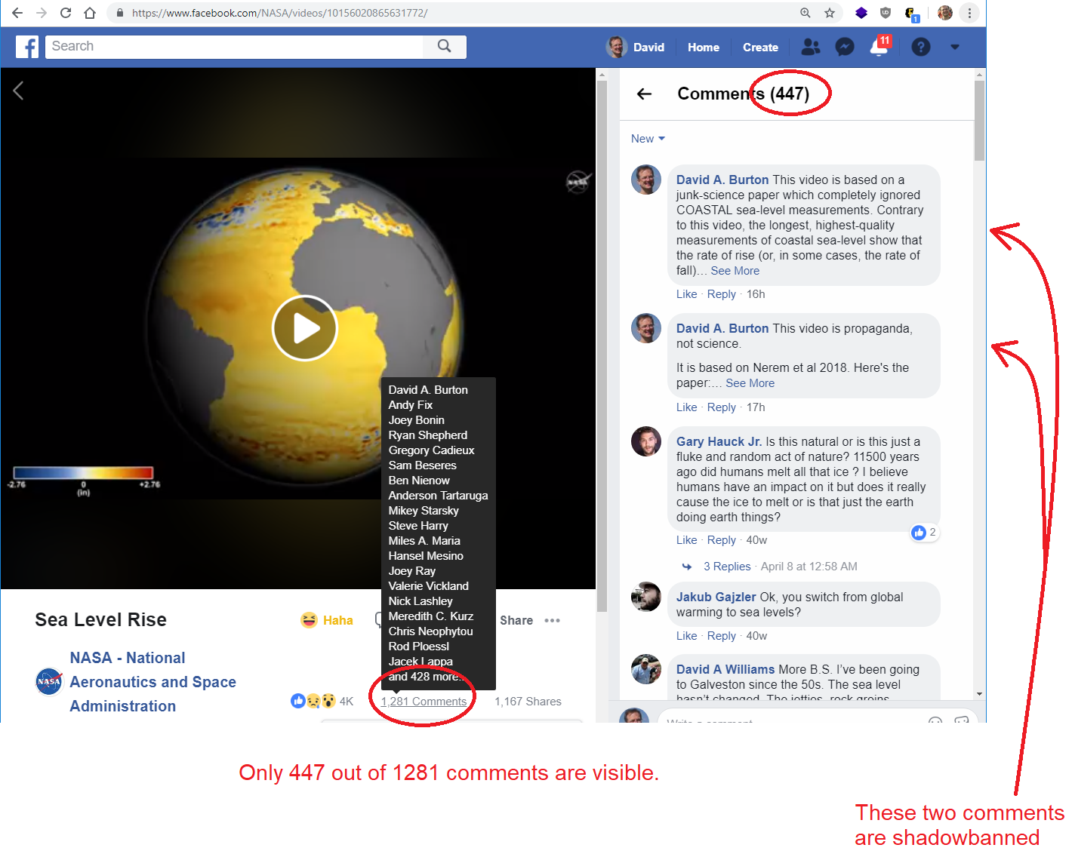

Slide 44
Bottom line:
Sea-level measurement data from the best individual tide gauges is rock-solid.
Satellite altimetry… not so much.

Slide 45
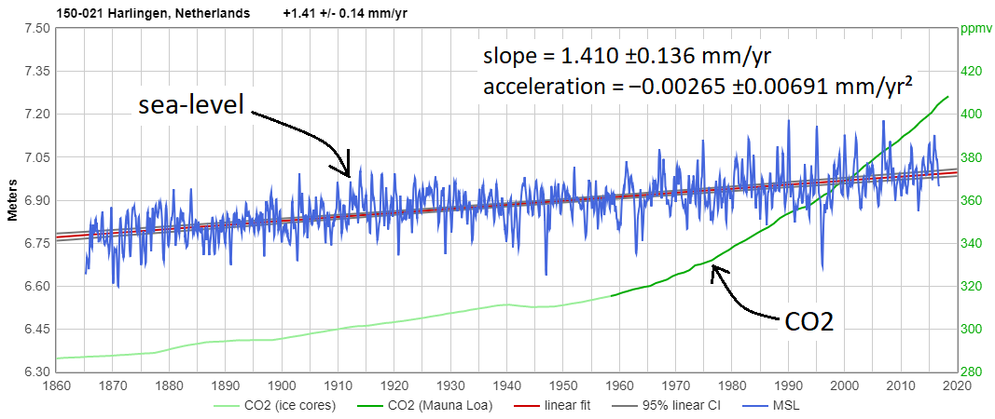
The best tide gauges show no acceleration in sea-level rise since the 1920s or before

Slide 46
So, why isn’t sea-level rise accelerating?

Slide 47
So, why isn’t sea-level rise accelerating?
Climate alarmists are sure that sea-level rise must accelerate, in a warming climate!

Slide 48
So, why isn’t sea-level rise accelerating?
“...an increased rate of sea level rise [must occur because of] the laws of physics. ...the two main factors in sea level rise are the thermal expansion of the ocean and the melting of landfast ice. ... For [sea level rise to not increase] would require that either temperature will not increase in the twenty first century (too implausible to be taken seriously), or that increased temperature will not lead to thermal expansion of seawater or melting of landfast ice (physically impossible).”
Foster, G. & Brown, P.T. (2015). Clim Dyn 45: 291

Slide 49
What causes sea-level change?
Local processes: VLM, erosion, sedimentation
Global sea-level rise:
Meltwater & sublimation (from grounded ice)
Iceberg calving
Mostly-local sea-level rise:
Thermal expansion
Global sea-level decline:
Snowfall accumulation!

Slide 50
Which ones increase w/ warming?
Local processes: VLM, erosion, sedimentation
Global sea-level rise:
Meltwater & sublimation (from grounded ice)
Iceberg calving
Mostly-local sea-level rise:
Thermal expansion
Global sea-level decline:
Snowfall accumulation!

Slide 51
Which ones increase w/ warming?
Local processes: VLM, erosion, sedimentation
Global sea-level rise:
Meltwater & sublimation (from grounded ice)
Iceberg calving
Mostly-local sea-level rise:
Thermal expansion
Global sea-level decline:
Snowfall accumulation!

Slide 52
SNOWFALL is the LARGEST contributor to grounded ice mass changes
In Greenland, snowfall accumulation is the largest contributor to ice mass changes
In Antarctica, snowfall accumulation is approximately equal to the sum of melting + iceberg calving + sublimation

Slide 53
Grounded ice
Greenland
Antarctica
other glaciers

Slide 54
Glaciers
Some glaciers are advancing
More glaciers are retreating
But the rate doesn’t appear to have accelerated in response to rising GHG levels

Slide 55
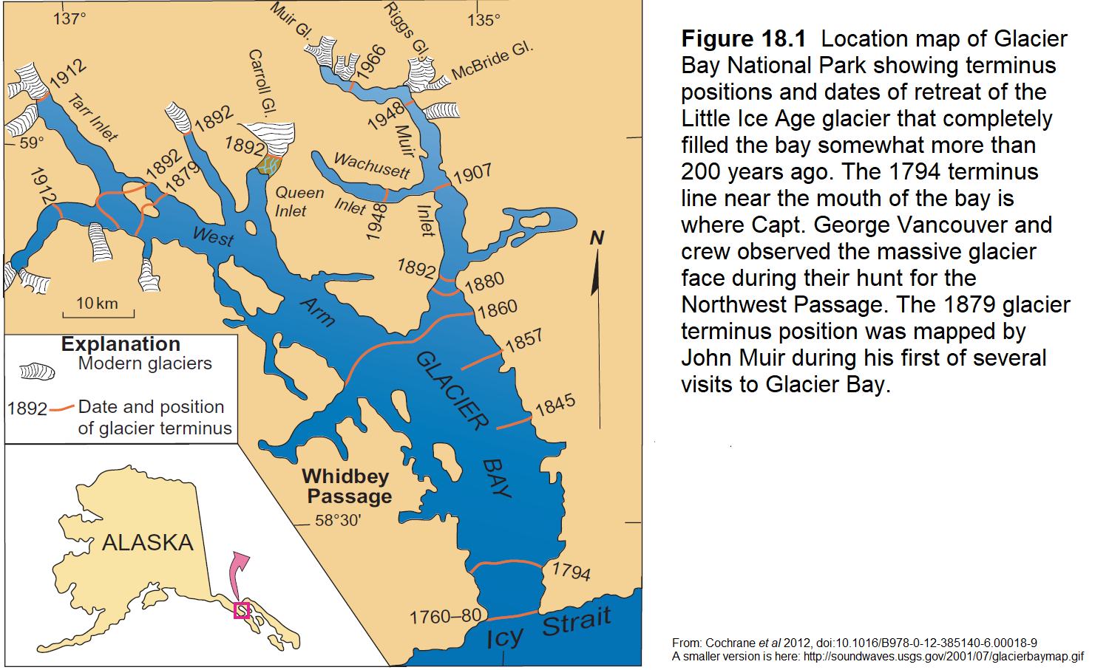
Glaciers

Slide 56
Antarctica
Averages more than 40° below zero
Ice loss & gain are so closely balanced that studies differ on whether it is gaining or losing ice
Either way, all studies agree that the rate, whether up or down, is less than the equivalent of 3 inches of sea-level change per century

Slide 57
Greenland
Net loss of about 200 Gt of ice in a typical year (DMI)
Rate equivalent to 2.2 inches/century
Not accelerating
In fact, Greenland had no net loss of ice in either of the last two glaciological years

Slide 58
Greenland
At the current average rate of ice loss (200 Gt/year), to melt the Greenland Ice Sheet entirely would take about 130...
‍‍‍‍‍‍ ‍‍

Slide 59
Greenland
At the current average rate of ice loss (200 Gt/year), to melt the Greenland Ice Sheet entirely would take about 130...
‍‍‍‍‍‍ ‍‍
...did you think "years?”
‍‍‍‍‍‍ ‍‍

Slide 60
Greenland
At the current average rate of ice loss (200 Gt/year), to melt the Greenland Ice Sheet entirely would take about 130...
‍‍‍‍‍‍ ‍‍
...did you think "years?”
‍‍‍‍‍‍ ‍‍
Nope, not years.
‍‍‍‍‍‍ ‍‍
Not decades, either.
‍‍‍‍‍‍ ‍‍

Slide 61
Greenland
At the current average rate of ice loss (200 Gt/year), to melt the Greenland Ice Sheet entirely would take about 130...
‍‍‍‍‍‍ ‍‍
...did you think "years?”
‍‍‍‍‍‍ ‍‍
Nope, not years.
‍‍‍‍‍‍ ‍‍
Not decades, either.
‍‍‍‍‍‍ ‍‍
Centuries. 130 centuries.

Slide 62

Glacier Girl

Slide 63
Glacier Girl
Glacier Girl is a Lockheed P-38 Lightning which was extracted in pieces from beneath 268 feet of accumulated ice and snow (mostly ice), fifty years after she landed on the Greenland Ice Sheet.

Slide 64
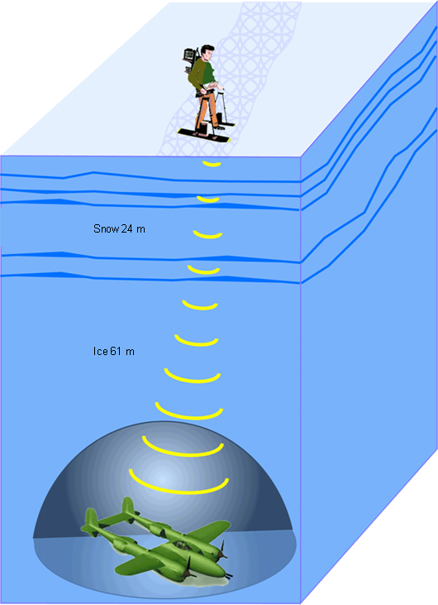

Slide 65
Glacier Girl
That’s more than 5 feet of ice per year, averaging about 70 feet of snow per year, totaling about 2/3 of a mile of accumulated snowfall.
That snow represents evaporated water, mostly removed from the Arctic and North Atlantic Oceans, which then fell as ocean-effect snow on the Greenland Ice Sheet.

Slide 66
So, what happens to snowfall in a warming climate?
It increases, for two reasons.
One reason is that warmer air holds more moisture. Very roughly, a single degree Celsius of warming increase the amount of moisture the air can carry by about six to seven percent. So, as long as the temperature stays below freezing, the warmer it gets, the greater the snowfall; when temperatures are very low there’s little snowfall, because the air holds very little moisture. That’s why the largest snowstorms usually occur when temperatures are only slightly below freezing.
Another reason is that a warmer climate should reduce sea-ice extent, increasing evaporation from the Arctic, North Atlantic, North Pacific, and Southern Oceans, and increasing Lake/Ocean-Effect Snowfall (LOES) downwind. When that snow falls on the ice sheets, it adds to ice mass accumulation and subtracts from sea-level.

Slide 67
Conclusion
So in a warming climate we know that there are some factors which increase sea-level, and other factors which reduce sea-level. There's no fundamental reason to suppose that either of those will dominate the other.

Slide 68
Conclusion
So in a warming climate we know that there are some factors which increase sea-level, and other factors which reduce sea-level. There's no fundamental reason to suppose that either of those will dominate the other.
We can, however, draw upon the historical record, to gain insight. At the best tectonically stable locations, sea-level has been rising at about 1½ mm/year (6 inches per century) since the 1920s or before, with no sign of significant acceleration due to rising CO2 levels.

