Slide 1
What everyone should know about “Global Warming” & Sea-Level Rise
By Dave Burton
Member, North Carolina Sea Level Rise Impact Study Advisory Committee,
IPCC AR5 Working Group 1 Expert Reviewer
Currituck, NC July 27, 2012
(updated 9/9/2014)

Slide 2
“Carbon pollution”
Carbon dioxide (CO₂) emissions
From burning fossil fuels, breathing, etc.
Plants: CO₂ + H₂O + sunlight → oxygen (O₂) + hydrocarbons
(hydrocarbons = food, wood, oils, etc.)
Animals: oxygen (O₂) + food → CO₂

Slide 3
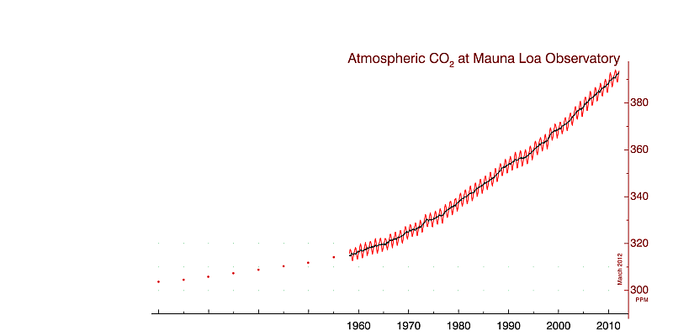
CO2 levels are up ~100 ppm

Slide 4

What does “carbon pollution” do to plants?
http://youtu.be/cl4kgnAObQ4
plantsneedco2

Slide 5
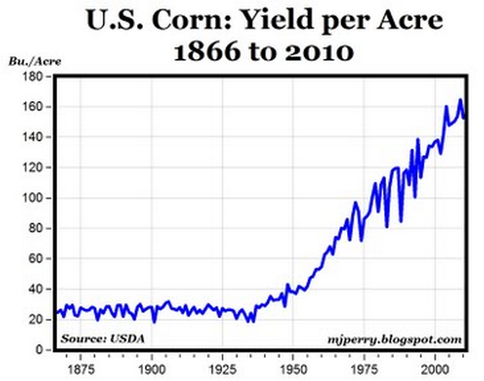
What does “carbon pollution” do to plants?
Cowpeas use “C3” photosynthesis (like most crops)
C3 plants benefit most from additional CO2
What about “C4” plants, like corn?

Slide 6
What does “carbon pollution” do to sea level?
But first, a digression . . .

Slide 7
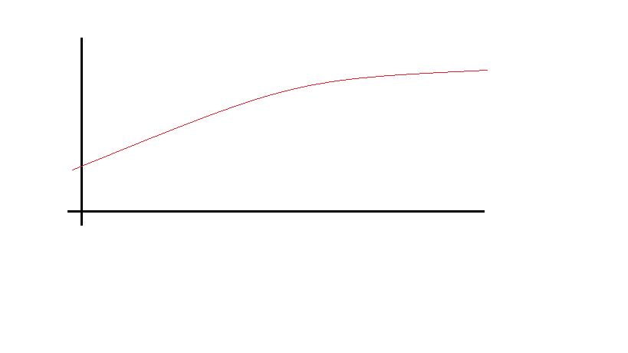

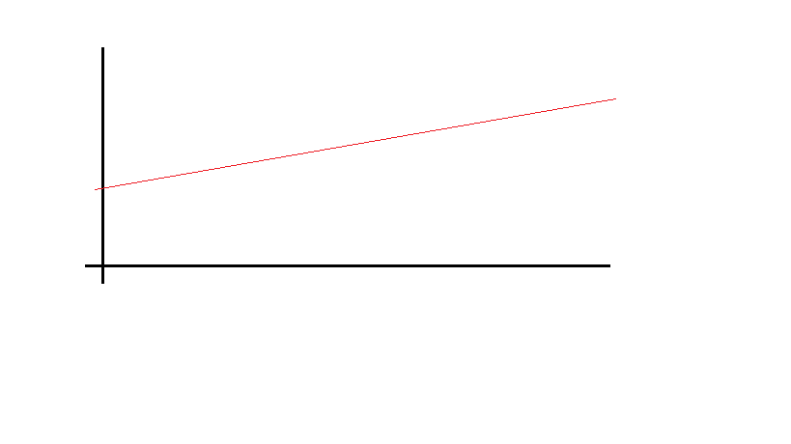
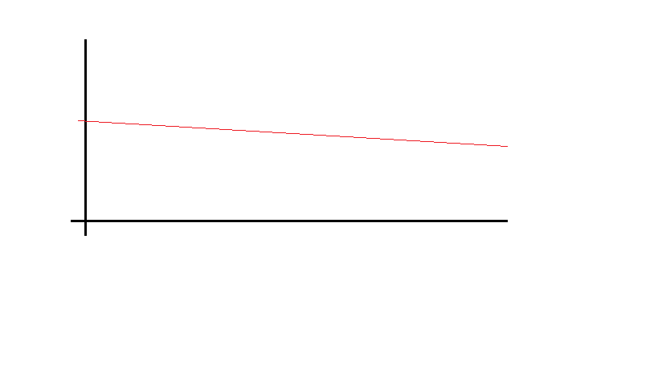
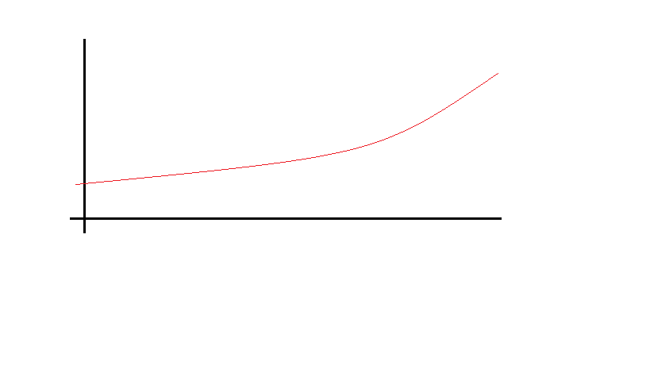
Key concept: Acceleration
Time (years)
Does the rate of sea level rise increase or decrease, and by how much?

Slide 8
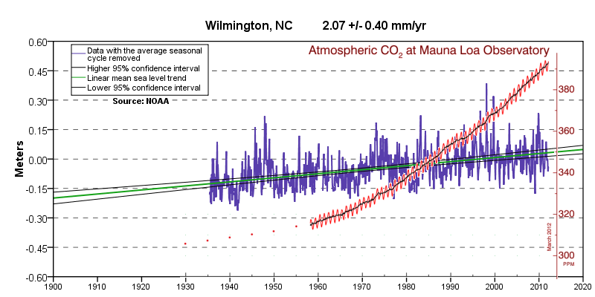
What does “carbon pollution” do to sea level?

Slide 9
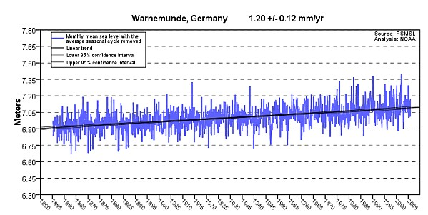
Tide gauges show no acceleration
(Graphs downloaded from NOAA.gov)

Slide 10
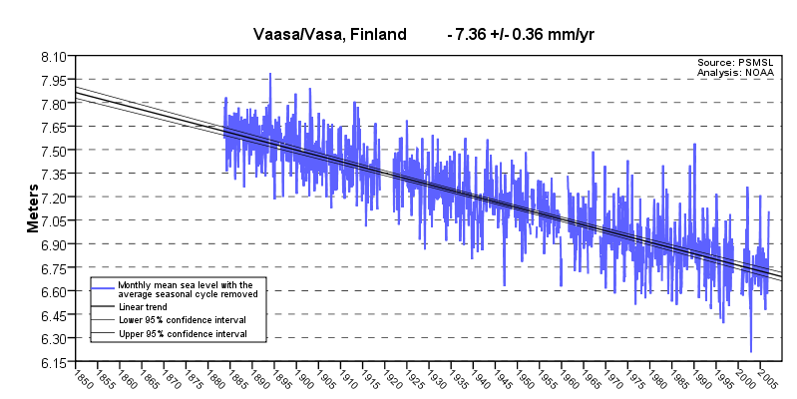
Tide gauges show no acceleration
At 25% of the GLOSS-LTT tide stations, LMSL is falling

Slide 11
Digression:
Why it varies: Subsidence & uplift
Crust of the earth floats on a ball of molten magma, and it’s sloshing!
Water, oil & natural gas wells – subsidence
Northeastern NC has less bedrock than SE NC

Slide 12
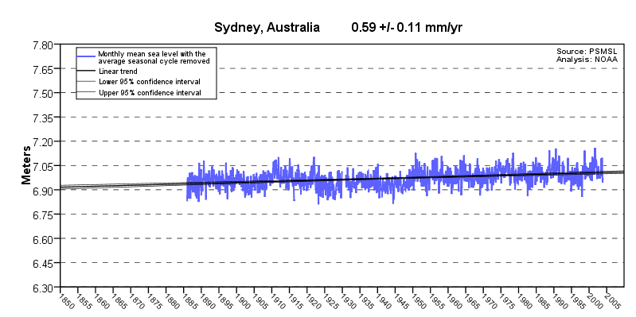
Tide gauges show no acceleration

Slide 13
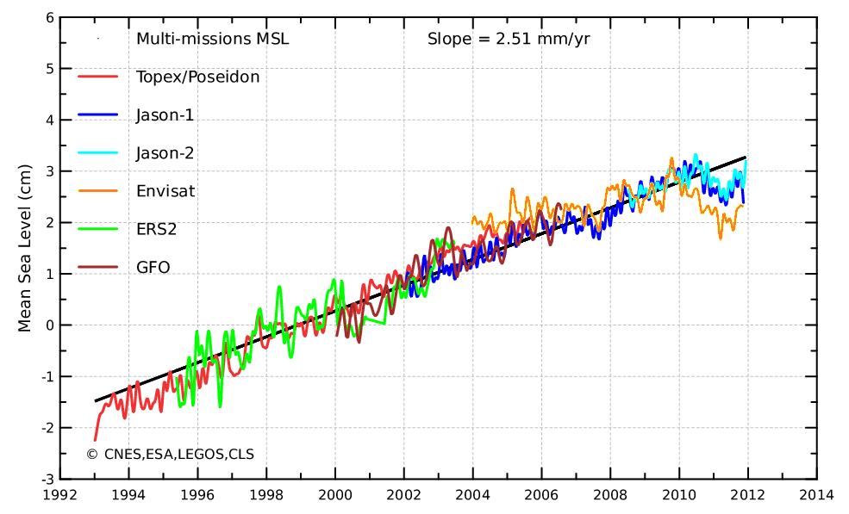
Satellites show no acceleration

Slide 14
Take-away point:
No increase in rate of Sea Level Rise (no acceleration) in last ~80 years!
Notes:
14

Slide 15
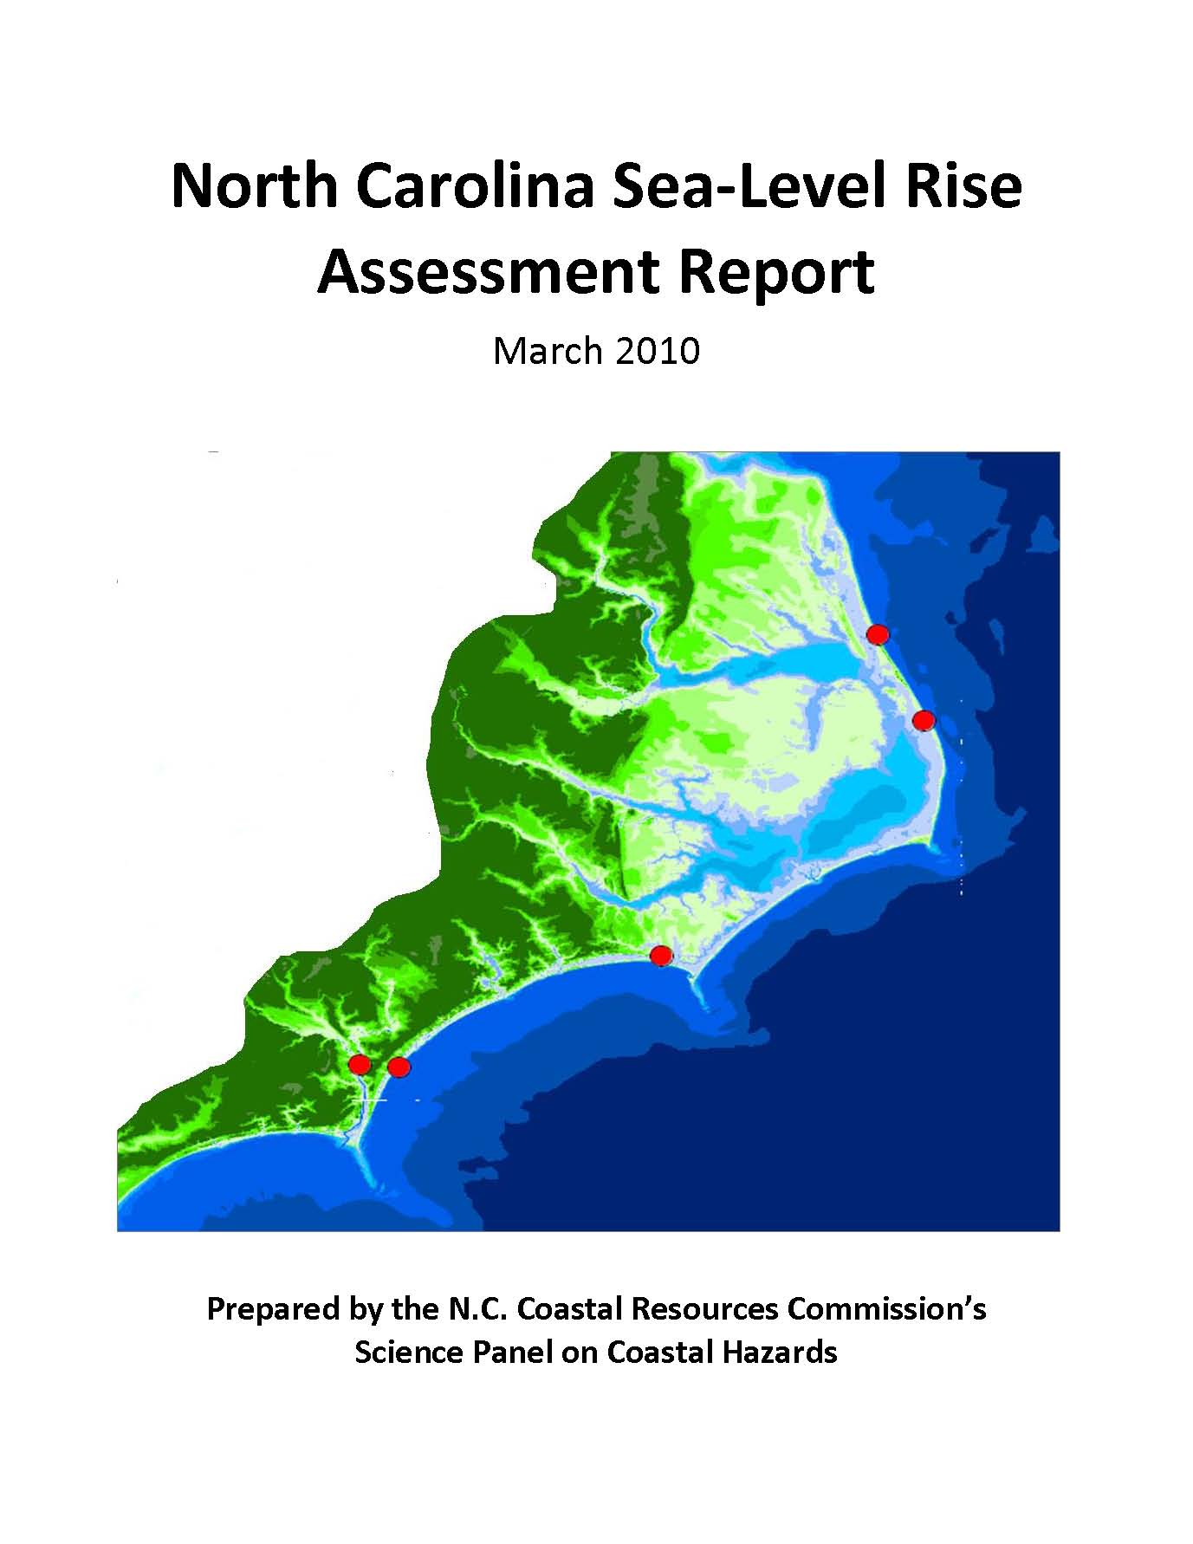
How Much Sea Level Rise Should We Expect by 2100?
Notes:
15

Slide 16
The Danger: Planning or Regulation?
“For the past 30 years, our policies and strategies have been based on a SLR rate of 1-foot to 1 1/2-feet per century.
However, based on the recommendation from the CRC’s Science Panel on Coastal Hazards (March 2010), the NC Coastal Resources Commission has adopted a rise of 1 meter by 2100 for planning purposes. This accounts for an accelerated rise.”
2010 DCM Assessment and Strategy Document, p. 12
Notes:
16

Slide 17
The Danger: Planning or Regulation?
“Sea level Rise: Rising sea level is a threat to coastal and riparian wetlands in North Carolina...
[Tide] gauge data specific to North Carolina are available only for 20 years, but suggest a... rate of approximately 4.57 mm per year (1.5 ft per 100 years). …
Rising sea levels will inundate large areas of the Albemarle-Pamlico Peninsula...”
2010 DCM Assessment and Strategy Document, p. 15
Notes:
17

Slide 18
The Danger: Planning or Regulation?
“The Science Panel's report... goes on to recommend that the CRC adopt a rise of one meter by 2100 as a planning level. The report represents a secure foundation upon which the CRC can proceed to pursue program changes...
The Science Panel's report is ready to be translated into policy... for changes to the regulatory program.”
2010 DCM Assessment and Strategy Document, pp. 106-107
Notes:
18

Slide 19
Claim:
(p.3): “This report synthesizes the best available science on SLR...”
No, it doesn’t!
But the Report’s problems are far from unique.
Notes:
19

Slide 20
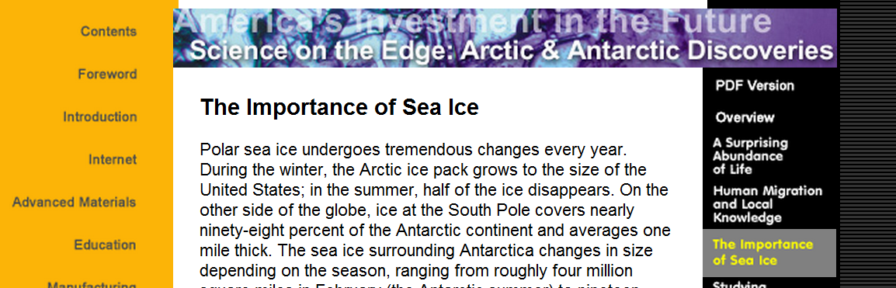
Climate misinformation is rampant
For example…
http://www.nsf.gov/about/history/nsf0050/arctic/seaice.htm
On the National Science Foundation web site…
Notes:
20

Slide 21
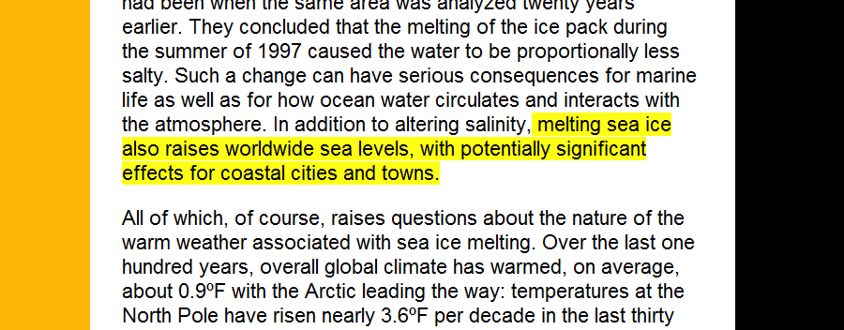
Climate misinformation is rampant
http://www.nsf.gov/about/history/nsf0050/arctic/seaice.htm
On the National Science Foundation web site…
for 6.5 years!
…and any competent high school science teacher could tell you that it is nonsense. (Archimedes!)
Notes:
21

Slide 22
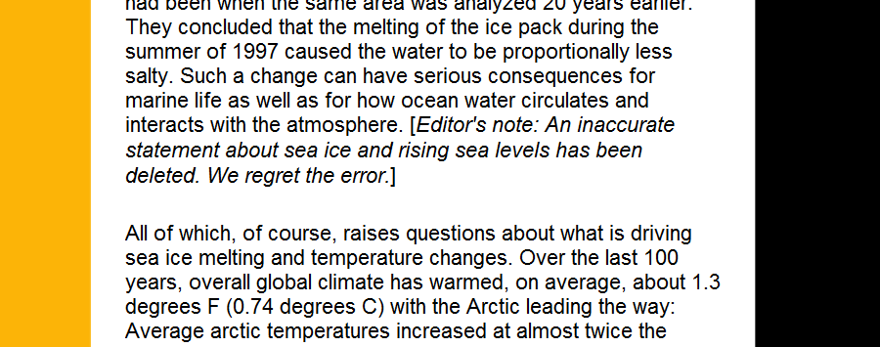
Climate misinformation is rampant
http://www.nsf.gov/about/history/nsf0050/arctic/seaice.htm
Finally fixed …
after 6.5 years!
Notes:
22

Slide 23
http://www.aip.org/history/climate/othergas.htm
American Institute of Physics
“…some of the methane was converted into ozone and water vapor in the stratosphere, where they would exert their own greenhouse effects."
From January, 2003 until September, 2014 (when I got them to fix it)
On Sun, Sep 7, 2014 at 8:04 AM, Spencer Weart <sweart@aip.org> wrote:
Right, it's CO2, not ozone, don't know how that crept in. I've made the correction on
> the website. Thanks
> On Tue, Aug 19, 2014 at 1:47 AM, David Burton wrote:
> > Did you mean to say carbon dioxide, rather than ozone?
> > Warmest regards,
> > Dave
> > www.sealevel.info

Slide 24
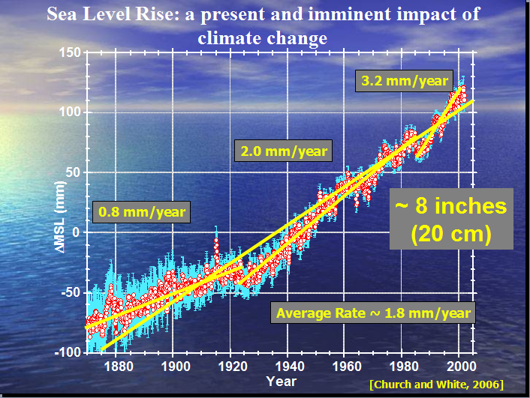
Confirmation Bias
NASA JPL Climate Symposium, Oct 24, 2009 (Lee=Leung Fu)

Slide 25
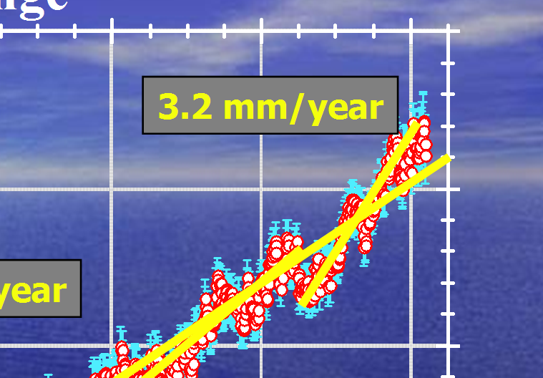
Confirmation Bias

Slide 26
NOAA’s list of
159 GLOSS-LTT tide gauges
The best long-term sea level data we have
1985: the Intergovernmental Oceanographic Commission (IOC) created the Global Sea Level Observing System (GLOSS)
Sea level data from a global network of tide stations.
NOAA lists 159 tide stations with long (avg. ~85 year) measurement records
Monitor long term sea level trends around the world
One of the gauges is in Wilmington!
Notes:
26

Slide 27
NOAA’s list of
159 GLOSS-LTT tide gauges
Sea level rises or falls at different rates in different places: -8 mm/year to +6 mm/year
Median: +1.1 mm/year (4” / century)
Geographically-weighted average: +1.1 mm/year *
Notes:
27

Slide 28
Why it varies: Subsidence & uplift
Crust of the earth floats on a ball of molten magma, and it’s sloshing!
Post-glacial rebound (GIA) – mostly uplift
Water, oil & natural gas wells – subsidence (and phosphate mining?)
Northeastern NC has less bedrock than SE NC
Notes:
28

Slide 29
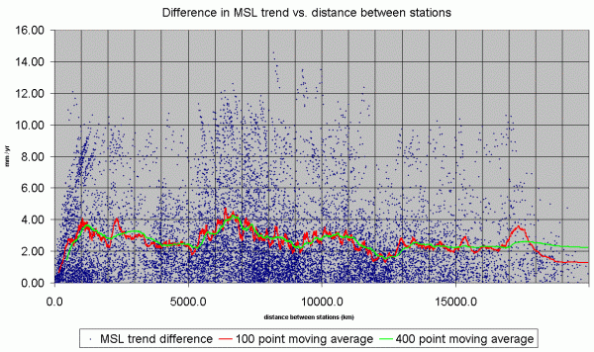
* Geographical weighting – how far apart for independence?
Notes:
29

Slide 30
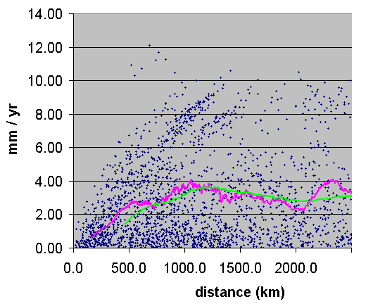
* Geographical weighting – how far apart for independence?
Notes:
30

Slide 31
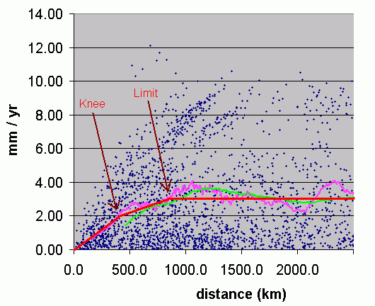
* Geographical weighting – how far apart for independence?
Weighting function ¹
Result: ~1.1 mm/year is a pretty good estimate of GMSL rise
Notes:
31

Slide 32
MSL Trend
+1.090 mm/yr | (measured, median)
+0.611 mm/yr | (measured, avg1, equal station weights)
+0.458 mm/yr | (measured, avg2, equal station-year weights)
+1.133 mm/yr | (measured, distance-weighted avg) ± 0.113 mm/yr
+1.7 - 1.8 mm/yr | (IPCC claim)
+1.200 mm/yr | 2013 list, 60+ yr stations, median
+1.410 mm/yr | 2013 list (all 285 stations), median
+1.273 mm/yr | 2013 list (all 285 stations), average
Conclusion: IPCC exaggerates the actual, measured, average rate of coastal MSL rise by 0.3 to 0.6 mm/yr
Notes:
32

Slide 33
IPCC AR4 (2007)
(the fine print)
“Trends in tide gauge records are corrected for GIA using models, but not for other land motions.”
[AR4, WG1, Sec. 5.5.2.1]
Notes:
33

Slide 34
John Daly
"The impression has been conveyed to the world's public, media, and policymakers, that the sea level rise of 18 cm in the past century is an observed quantity and therefore not open to much dispute. What is not widely known is that this quantity is largely the product of modeling, not observation, and thus very much open to dispute, especially as sea level data in many parts of the world fails to live up to the IPCC claims."
Notes:
34

Slide 35
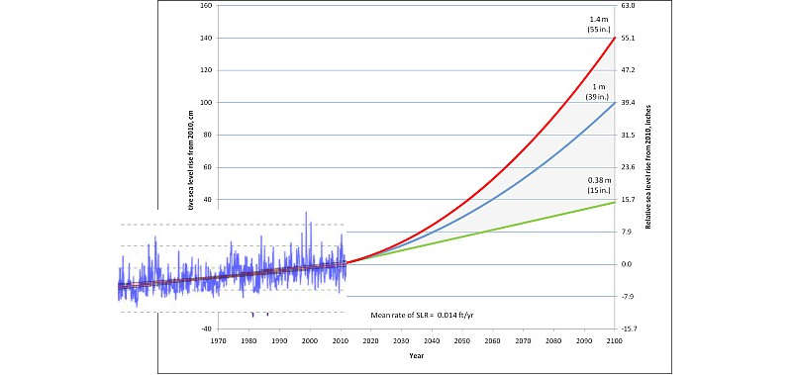
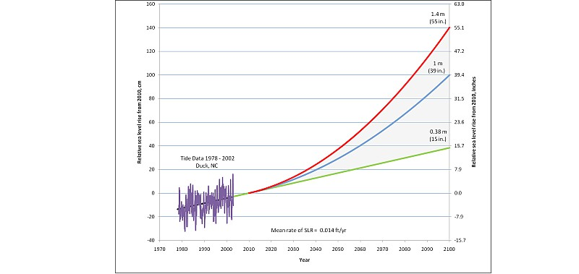
CRC Science Panel Report
Mythical acceleration
2010 NC SLR AR predicts huge acceleration in SLR
Notes:
35

Slide 36
Sea level rises or falls at different rates in different places: -8 mm/year to +6 mm/year
So why Duck?
Notes:
36

Slide 37
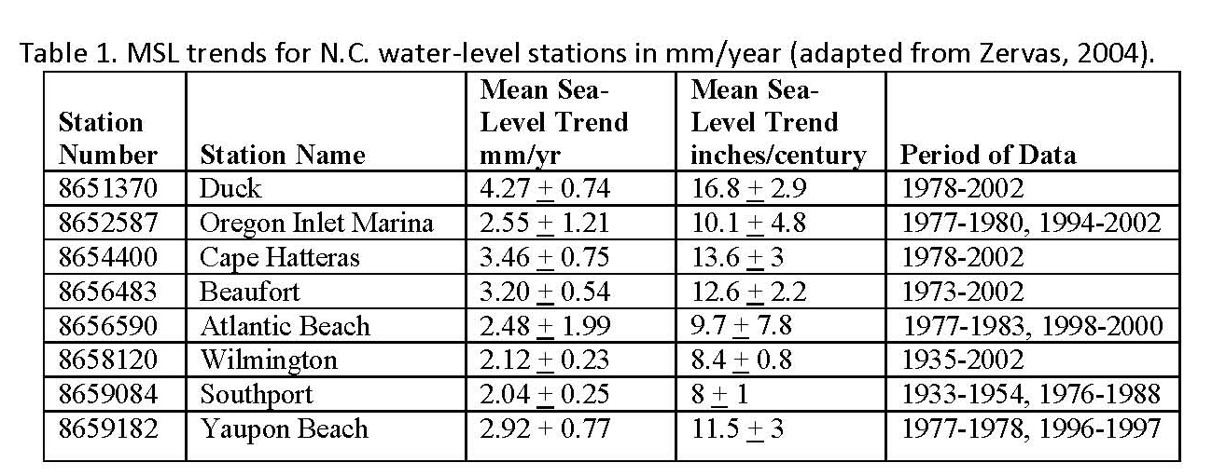
Why Duck?
CRC Science Panel Report
Notes:
37

Slide 38
CRC Science Panel Report
Mythical acceleration
and around 3 mm per year (0.12 inches/yr) over the last fifteen years.
Claim (p.6): “Currently, MSL is rising at a rate of approximately 2 mm per year (0.08 inches/yr) if averaged over the last hundred years,
The rate of MSL rise has increased in response to global warming.”
Notes:
38

Slide 39
Not According to the Peer Reviewed Literature
Douglas (1992), Journal of Geophysical Research (JGR), analyzed world-
wide gauges and found a deceleration from 1905-1985
Jevrejeva et al (2006), JGR, found a deceleration for 20th Century
Holgate (2007), Geophysical Research Letters, found a deceleration
from 1904-2003
Church et al (2004), Journal of Climate, found no increase in the rate of
sea level rise from 1950-2000
Woodworth (2006), Philosophical Transactions of the Royal Society, said
“... No definitive long-term acceleration of sea level has been identified
using 20th Century data alone”
Woodworth et al (2009), International Journal of Climatology, note
“… little evidence has been found in individual gauge records for an
ongoing positive acceleration of the sort suggested for the 20th
Century by climate models”
“Global Sea Level Change in the 20th Century and Recent Satellite Results”
Bob Dean and Jim Houston NC-20, New Bern, NC October 7, 2011
Notes:
39
ERDC Team
Virtual Team
2031 Employees (Full Time Federal)
Highly Educated – over 80 colleges/universities represented

Slide 40
Summary
Over the last year, we have conducted extensive analyses of quality tide gauge data including world wide and U. S. gauges.
The results of all of our analyses are consistent - There is no indication of an overall world-wide sea level acceleration in the 20th Century data. Rather, it appears that a weak deceleration was present.
“Global Sea Level Change in the 20th Century and Recent Satellite Results”
Bob Dean and Jim Houston NC-20, New Bern, NC October 7, 2011
Notes:
40

Slide 41
CRC Science Panel Report
Mythical acceleration
“2 mm/year” comes from averaging and adjusting coastal tide station trends
“3 mm/year” is measurement of a different quantity: satellite-measured mid-ocean sea level.
Notes:
41

Slide 42
No measurable acceleration to date
“...anticipated, but not-yet-observed, acceleration due to climate warming...
...it is important to note that most sea-level studies... do not observe any recent acceleration in the rate of rise.”
Spencer Rogers, June 1, 2012
Coastal Construction and Erosion Specialist , NC Sea Grant
Member, CRC Science Panel

Slide 43
CRC Science Panel Report
No actual increase in rate of SLR (“acceleration”) in last ~80 years!
Notes:
43

Slide 44
IPCC’s Third
Assessment Report (2001)
“observational finding of no acceleration in sea level rise during the 20th century.”

Slide 45
So, where do alarmists get their projected acceleration?
Confusion: tide gauge vs. satellite data
Church & White (2006)
Rahmstorf (2007)
Notes:
45

Slide 46
So, where do alarmists get their projected acceleration?
Confusion: tide gauge vs. satellite data
Church & White (2006)
Rahmstorf (2007)
Notes:
46

Slide 47
Church and White (2006)
Their claim:
“A 20th century acceleration in global sea-level rise.”
But “no 20th century acceleration has previously been detected” by other researchers.
Notes:
47

Slide 48
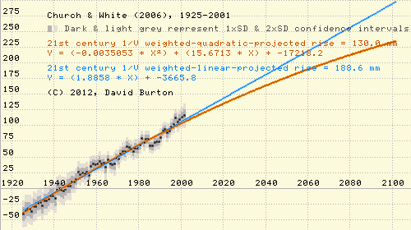
Church and White (2006)
But I reproduced their regression analysis, and found that all the acceleration was before 1925 (before most CO2 increase):
Church & White 2006 data, 1925-2001, minimum-variance unbiased estimator quadratic fit regression analysis showing a small deceleration in rate of sea level rise.
Notes:
48

Slide 49
Church and White (2009)
In 2009, they posted updated data to their web site.
I applied their regression analysis method to the new data…
Result for 20th century: deceleration!
I told Drs. Church & White about it. Dr. Church replied:
“…thank you … For the 1901 to 2007 period, again we agree with your result and get a non-significant and small deceleration.” (June 18, 2010 email attachment)
Notes:
49

Slide 50
Acceleration myth
Sources for the error:
Confusion: tide gauge vs. satellite data
Church & White (2006)
Rahmstorf (2007)
Notes:
50

Slide 51
“the Science Panel believes that the Rahmstorf method is robust and 1.4 meters a reasonable upper limit for projected rise.” [2010 NC SLR AR, p.11]
CRC Science Panel Report
Notes:
51

Slide 52
“Rahmstorf (2007) presented an approach ... based on a proposed linear relationship ... We find no such linear relationship. Although we agree that there is considerable uncertainty in the prediction of future sea-level rise, this approach does not meaningfully contribute to quantifying that uncertainty”
Holgate, S., Jevrejeva, S., Woodworth, P., and Brewer, S., 2007. Comment on “A semiempirical approach to projecting future sea level rise.” Science, 317, 1866.

Slide 53
“...this statistical analysis (Rahmstorf, 2007) is based on an application of statistics ... violating basic assumptions of the statistical methods used.”
Schmith, T., Johansen, S., and Thejll, 2007. Comment on “A Semi-Empirical Approach to projecting Future Sea-Level Rise,” Science, 317, 1866c.

Slide 54
“Rahmstorf and Vermeer (2011) have been selective in showing only data that appear to match their modeling and not the data that strongly disagree”
Houston, J.R. and Dean, R.G., 2011b. Discussion of “Sea-Level Acceleration Based on U.S. Tide Gauges and Extensions of Previous Global-Gauge Analyses” by J.R. Houston and R.G. Dean (Journal of Coastal Research, 27[3], 409-417, 2011): Response to Discussion by S. Rahmstorf and M. Vermeer (2011).

Slide 55
“the Science Panel believes that the Rahmstorf method is robust and 1.4 meters a reasonable upper limit for projected rise.” [2010 NC SLR AR, p.11]
CRC Science Panel Report
“In hindsight, the averaging period of 11 years that we used in the 2007 Science paper was too short to determine a robust climate trend…
[Stefan Rahmstorf's 2009 mea culpa, on the RealClimate blog ]
“It turns out that Rahmstorf has pulled an elaborate practical joke on the Community…” [Steve McIntyre]
More on Rahmstorf’s Method here: tinyurl.com/rahmstuff
Notes:
55

Slide 56
CRC Science Panel Report
Rahmstorf “projected sea-level rise in 2100 of 0.5 to 1.4 meters above the 1990 level.” (110 years)
2010 NC SLR Assessment Report projects for a 90 year period

Slide 57
We’ve done the experiment!
Last ¾ century of anthropogenic CO₂ (>30% increase) caused no acceleration in SLR.
Irrational and unscientific to presume that the next ¾ century will be different.
Realistic projection for Wilmington and Southport is only about 7” by 2100 (10” for Morehead City, 16” for Duck)

Slide 58
2012 Addendum
“Why is acceleration expected this century when past data shows none?”
“The question of whether or not SLR is currently accelerating is a valid question…”
“...unclear from the existing data if the expected acceleration has begun.”
The addendum admitted to no errors, and didn't modify the 39" forecast by even one inch!
In 2010 the Panel thought sea-level rise had accelerated. In 2012 they knew it had not. Yet they still stubbornly projected the same 39". That's politics, not science!

Slide 59
P.S. -
There’s been a lot of silliness in the news lately, seeking to gin up concern over sea level rise:
A “hotspot” of acceleration along the NE U.S. coast?
Greenland ice melting?
If anyone has questions about such things, please don’t hesitate to ask.

Slide 60
Tom’s questions…
Is SLR accelerating? No.
Is it true that 98% of the scientists agree that it is? No.
http://tinyurl.com/Clim97pct
(97 responses used from survey of 10,257 Earth Scientists, & wrong questions!)
What is a denier? That’s a reference to Holocaust Deniers.
And why have we been labeled that by Dr. Orin Pilkey etc.? It’s not about science, it’s about ideology.
Is the climate getting warmer? Not lately – global temperatures have plateaued since Clinton Administration.
Is CO2 the cause? Modest contribution (fraction of a degree).
Is all the ice melting? No.
When ice melts, do the oceans rise? Grounded: yes, floating: no.

Slide 61
What everyone should know about “Global Warming” & Sea-Level Rise
By Dave Burton
Member, North Carolina Sea Level Rise Impact Study Advisory Committee,
IPCC AR5 Working Group 1 Expert Reviewer
Currituck, NC July 27, 2012
(updated 9/9/2014)
Notes:
61

